Slide 2
Dim

Slide 3


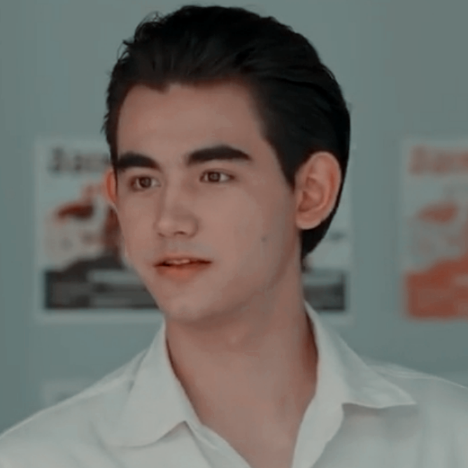



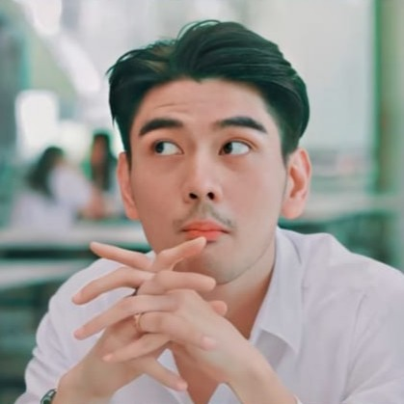




Slide 4





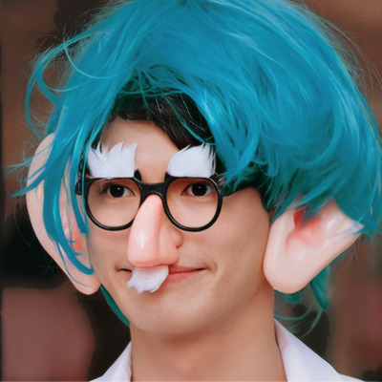




Slide 5




Slide 6




Slide 7


Slide 8

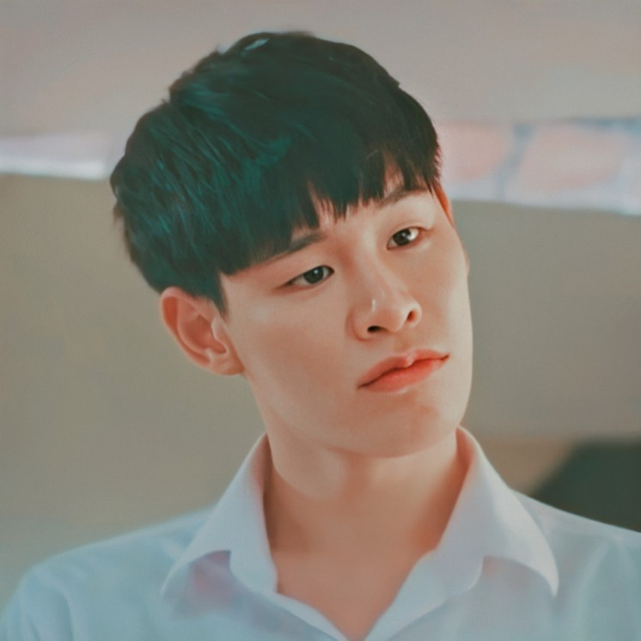
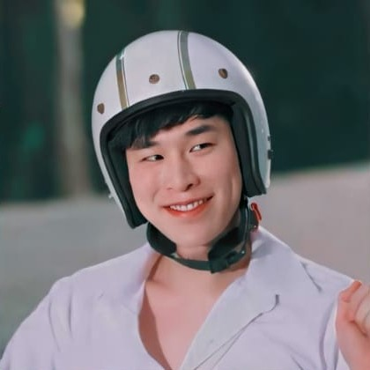


Slide 9


Slide 10
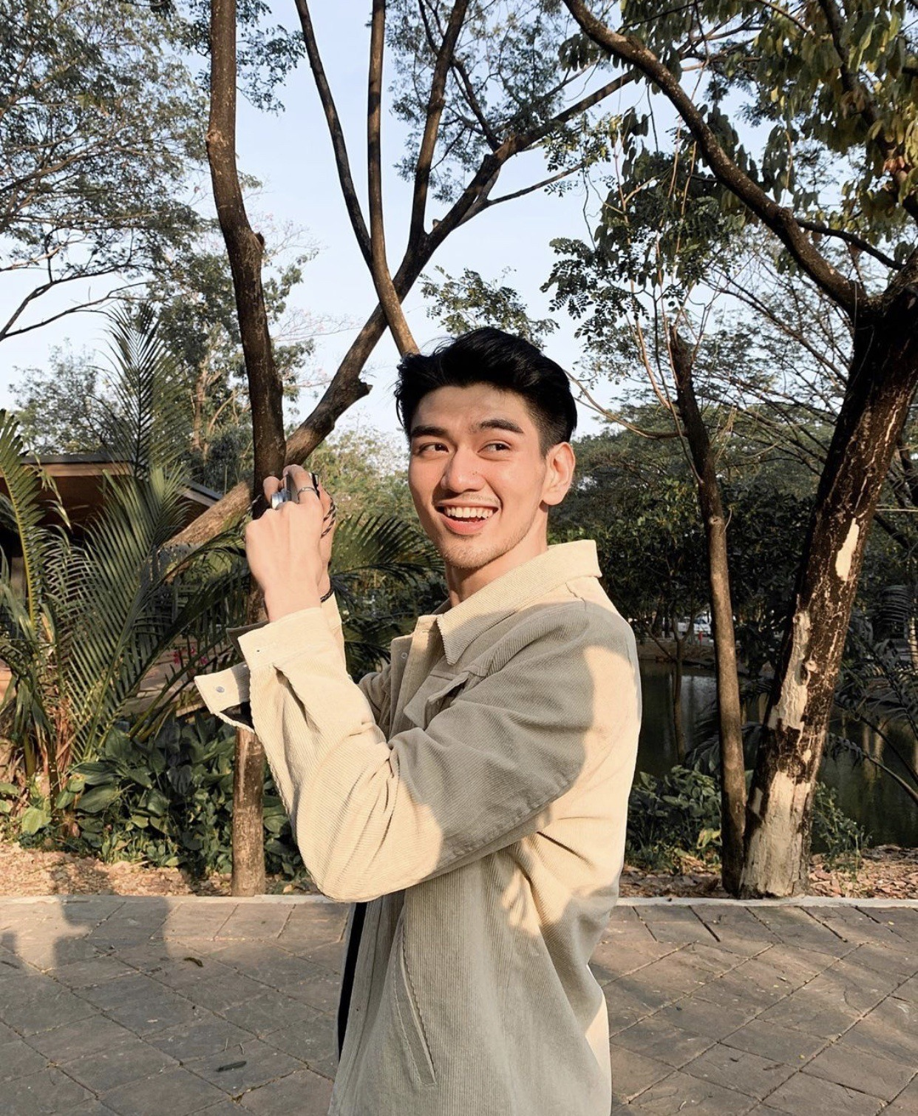



Slide 11


Slide 12


Slide 13



Slide 14
Dim
Pear
Earn
Green
Tine
Sarawat
Phukong
Mil
Type
Man

Slide 15

Dim
Pear
Earn
Green
Tine
Sarawat
Phukong
Mil
Type
Man

Slide 16

Dim
Pear
Earn
Green
Tine
Sarawat
Phukong
Mil
Type
Man

Slide 17

Dim
Pear
Earn
Green
Tine
Sarawat
Phukong
Mil
Type
Man

Slide 18

Dim
Pear
Earn
Green
Tine
Sarawat
Phukong
Mil
Type
Man

Slide 19
Dim
Pear
Earn
Green
Tine
Sarawat
Phukong
Mil
Type
Man

Slide 20

Dim
Pear
Earn
Green
Tine
Sarawat
Phukong
Mil
Type
Man

Slide 21

Dim
Pear
Earn
Green
Tine
Sarawat
Phukong
Mil
Type
Man

Slide 22

(almost) lovers
has a crush on/stalking
friends
brothers
mortal enemies

Slide 23


Slide 24


Slide 25


Slide 26


Slide 27


Slide 28


Slide 29


Slide 30


Slide 31


Slide 32


Slide 33
(almost) lovers
has a crush on/stalking
friends
brothers

Slide 35
Dim
Pear
Earn
Green
Tine
Sarawat
Phukong
Mil
Type
Man

Slide 36
Dim
Pear
Earn
Green
Tine
Sarawat
Phukong
Mil
Type
Man

Slide 37
Dim
Pear
Earn
Green
Tine
Sarawat
Phukong
Mil
Type
Man

